Slide 1
The years of life lost to the children of divorce (in the United States Alone) is the same as repeating the Oklahoma City Bombing 1,500 times a day every day of the year. We hope and pray your church will reach out to these children. We pray also that your Sunday School leaders forward this slide show to one another and visit www.childrenafterdivorce.com This month’s coloring book is: “God’s Healing for the Children of Divorce”
Click any image to download/print that page.
Click the links for even more Coloring Projects.
Use the arrows or click the outside edge of a slide to turn the page.
When clicking a link run your mouse over the entire code until the finger points UP. If it points sideways it will take you to the next or previous page instead of following the link.

Slide 2
Click any Image to print the page.
Click the links ONLY if the finger points up.
This Bible verse is a Blessing. Speak it out loud to your children. Blessings help them focus on God’s power and not their circumstances or feelings.
Don’t make your children do
without. Bless them…color WITH them….
Visit www.blessmyfamily.com
Click the page links to download this coloring page in
The New English Translation:
www.biblehome.org/pdf/setdiv/nd1net.pdf
The King James Translation:
www.biblehome.org/pdf/setdiv/nd1kj.pdf

Slide 3
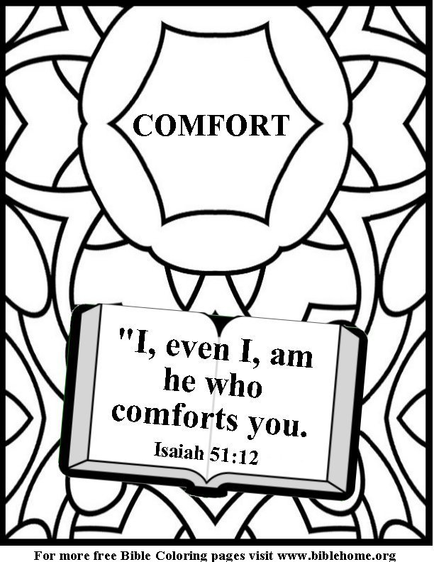
Turning away from God is the worst part of divorce. Don’t let it happen to you. Attend church this Sunday.
Click the page links to download this coloring page in
The New English Translation:
www.biblehome.org/pdf/setdiv/nd2net.pdf
The King James Translation: www.biblehome.org/pdf/setdiv/nd2kj.pdf

Slide 4
Most parents worry about the behavior of their children, drugs, sex, violence, school performance etc. The real problem is the forces that MOTIVATE children to misbehave …fear, anger, loneliness, hurt, loss. The leader of the parade is usually fear. This verse should be a foundation for every child of divorce.
Click the page links to download this coloring page in
The New English Translation:
www.biblehome.org/pdf/setdiv/nd3net.pdf
The King James Translation:
www.biblehome.org/pdf/setdiv/nd3kj.pdf
To view more than 20 coloring books with themes like: prayer, sin, Jesus, God, and more visit
http://www.biblehome.org

Slide 5
Blaming God is the opposite of a positive outlook.
If there is one single foundation for the children of divorce it is believing God loves them and that he can help them…even with a problem as big as divorce.
See the parent resources at
www.childrenafterdivorce.com
Click the page links to download this coloring page in
The New English Translation:
www.biblehome.org/pdf/setdiv/nd4net.pdf
The King James Translation: www.biblehome.org/pdf/setdiv/nd4kj.pdf
To view more than 20 coloring books with themes like: prayer, sin, Jesus, God, and more visit
http://www.biblehome.org

Slide 6
For some the winds of childhood are gentle breezes. Others live daily with hurricane force gales of fear, anger, loneliness, the breakup of their family…even death and war. None of us, parent or child, knows what is ahead of us. In the end all we have…any of us is: “Precious Promises. Don’t make your children do without. Visit www.bibleparent.com.
Click the page links to download this coloring page in
The New English Translation:
www.biblehome.org/pdf/setdiv/nd5net.pdf
The King James Translation: www.biblehome.org/pdf/setdiv/nd5kj.pdf
To view more than 20 coloring books with themes like: prayer, sin, Jesus, God, and more visit
http://www.biblehome.org

Slide 7
Some examples of God’s children who had family trouble are Joseph, Moses, Samuel, and Daniel. Joseph’s whole mixed up family was mad all the time. Moses did not get to live with the family he loved. Samuel was so lonely God spoke to him personally. Daniel was surrounded by ungodly people. God loved them all. Having family trouble does not put you at the bottom of God’s list. It moves you to the top.
Click the page links to download this coloring page in
The New English Translation:
www.biblehome.org/pdf/setdiv/nd1ne6.pdf
The King James Translation: www.biblehome.org/pdf/setdiv/nd6kj.pdf

Slide 8
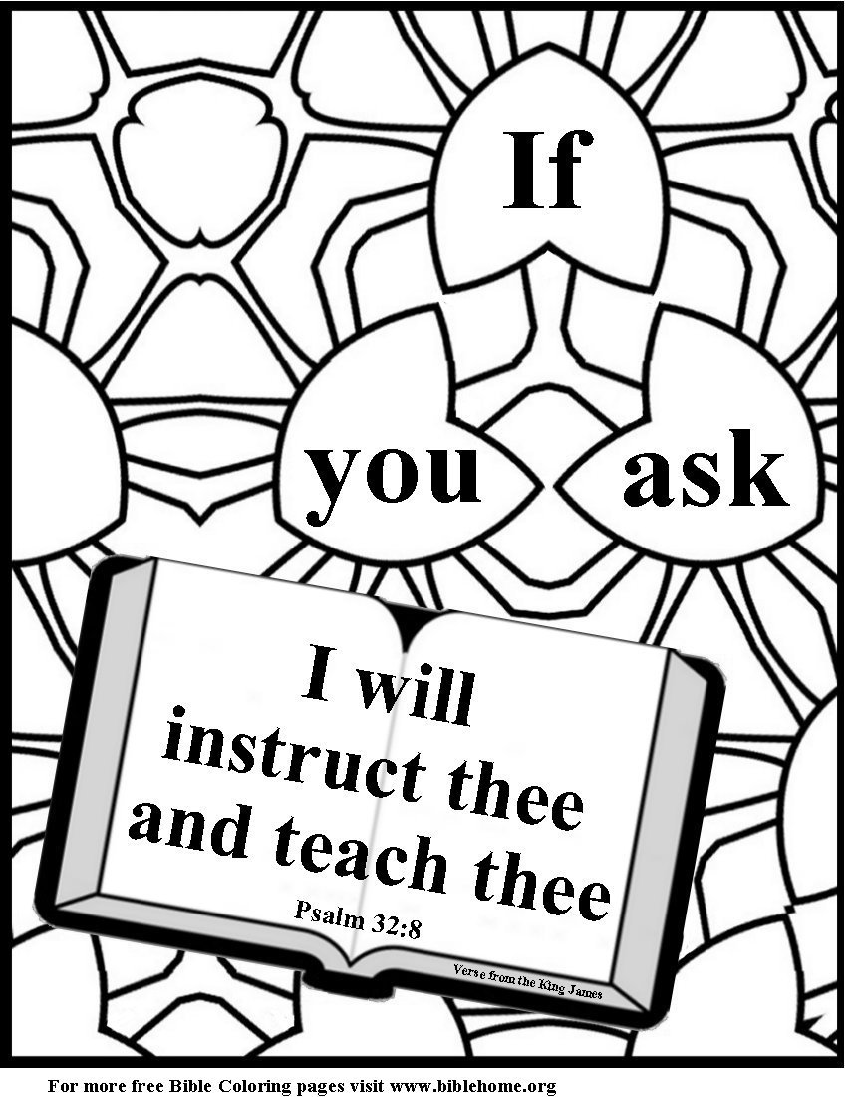
God’s help is only a prayer away. Praying with your children matters. It could be the start of a lifelong habit. Don’t make your children do without. Visit www.teachustopray.com
Click the page links to download this coloring page in
The New English Translation:
www.biblehome.org/pdf/setdiv/nd1ne7.pdf
The King James Translation: www.biblehome.org/pdf/setdiv/nd7kj.pdf
To view more than 20 coloring books with themes like: prayer, sin, Jesus, God, and more visit
http://www.biblehome.org

Slide 9
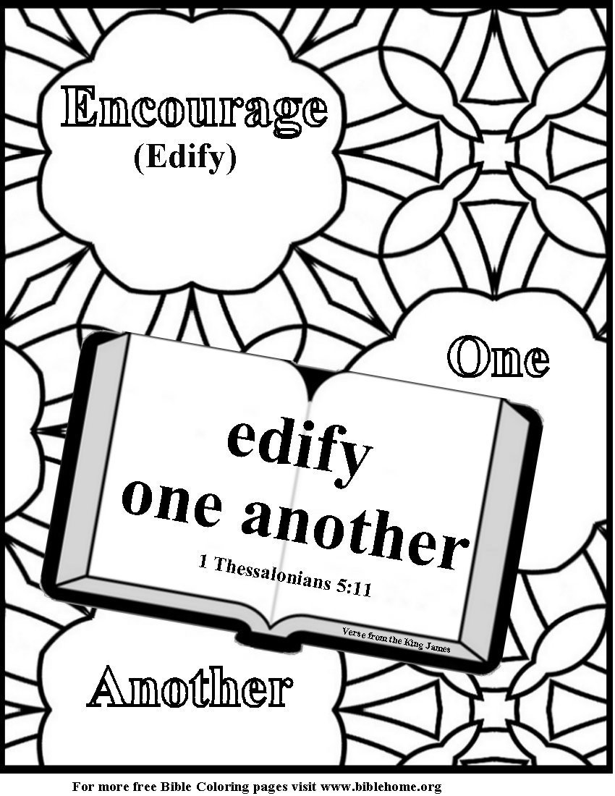
Whether you say encourage or edify the idea is to build one another up. We hope a few at least who look at our coloring book will visit www.blessmyfamily.com and use the pages to bless your children.
Click the page links to download this coloring page in
The New English Translation:
www.biblehome.org/pdf/setdiv/nd8net.pdf
The King James Translation: www.biblehome.org/pdf/setdiv/nd8kj.pdf
To view more than 20 coloring books with themes like: prayer, sin, Jesus, God, and more visit
http://www.biblehome.org

Slide 10
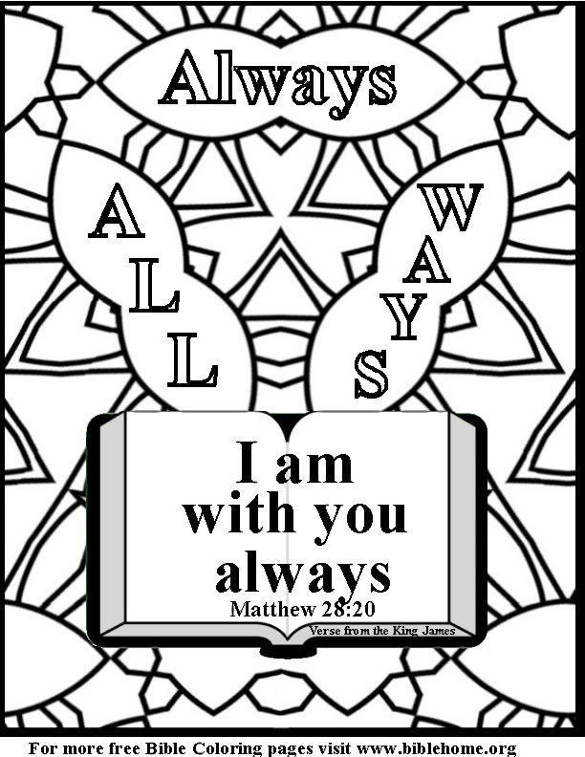
A very good way to help children understand and believe God really is with them is to send them out the door…every morning… with a Bible verse in their pocket. We invite you to visit www.bibleparent.com
Click the page links to download this coloring page in
The New English Translation:
www.biblehome.org/pdf/setdiv/nd9net.pdf
The King James Translation: www.biblehome.org/pdf/setdiv/nd9kj.pdf
To view more than 20 coloring books with themes like: prayer, sin, Jesus, God, and more visit
http://www.biblehome.org

Slide 11
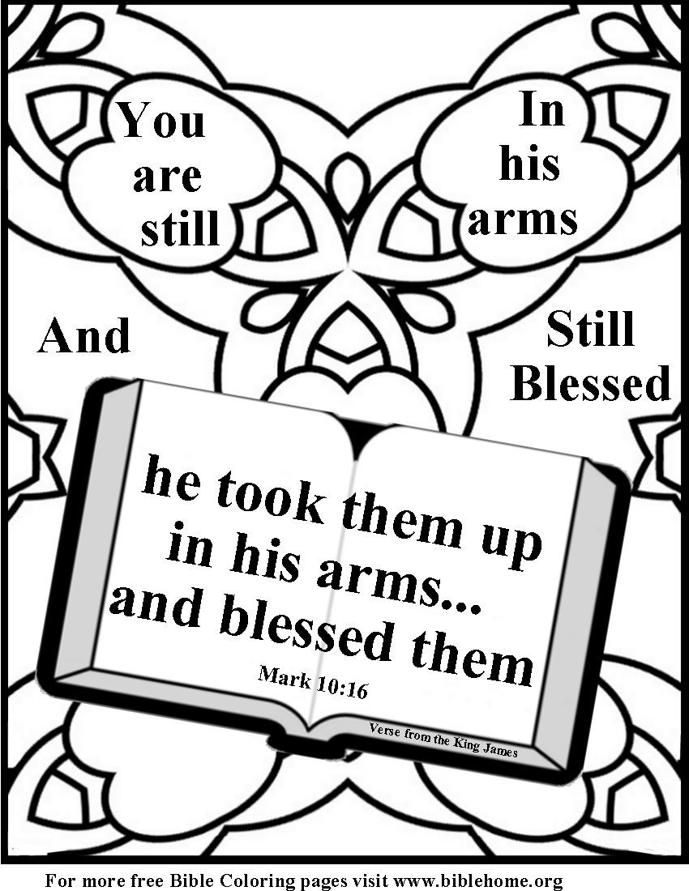
Being loved and feeling loved are not always the same thing. Ask yourself how you could make each of your children feel loved. The answer is usually spending a little time with them…each day …at a set time
To view more than 20 coloring books with themes like: prayer, sin, Jesus, God, and more visit
http://www.biblehome.org
Click the page links to download this coloring page in
www.biblehome.org/pdf/setdiv/nd10net.pdf
The King James Translation: www.biblehome.org/pdf/setdiv/nd10kj.pdf

Slide 12
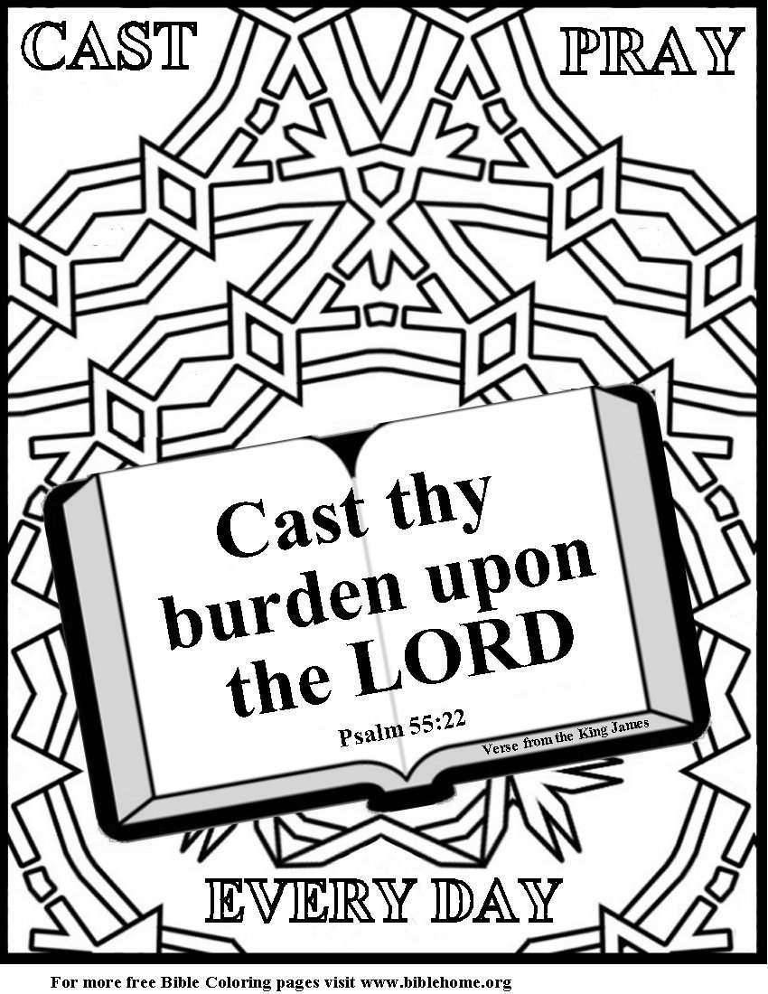
Trusting God to help with our problems is not natural. We have to work at it, especially when our problems are large ones. First we admit it is too much for you. Then we ask God for grace to TRUST him. Once learned it is never forgotten and life becomes good again.
To download page from the Internet:
The New English Translation: www.biblehome.org/pdf/setdiv/nd11net.pdf
The King James Translation: www.biblehome.org/pdf/setdiv/nd11kj.pdf
To view more than 20 coloring books visit: http://www.biblehome.org

Slide 13
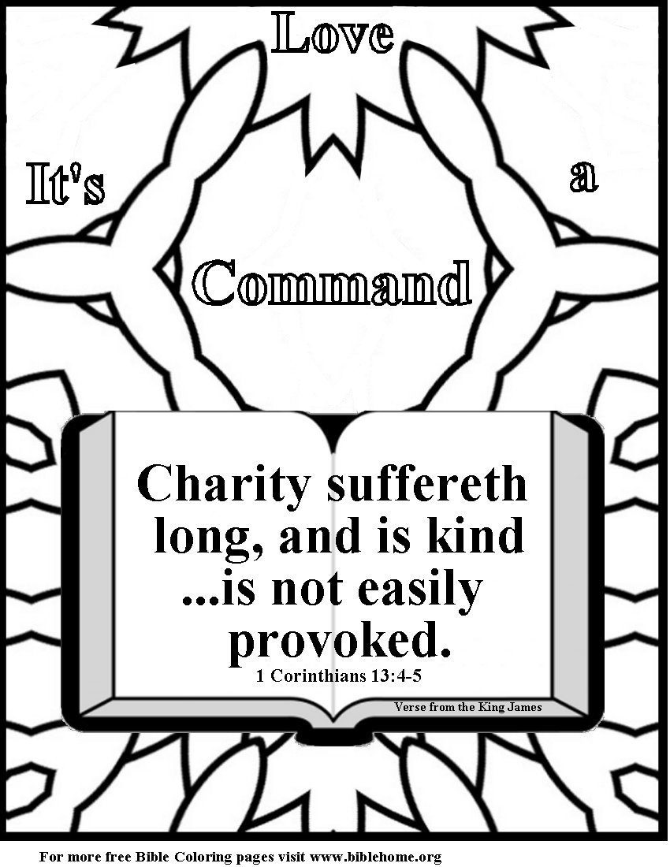
Love your ex. The biggest monster for the children of divorce is learning to be two people, one for dad and one for mom. Many many parents make the suffering worse by holding on to the anger that caused the divorce in the first place. Spare your children. Love your ex. God will help. It’s a command.
To download page from the Internet:
The New English Translation: www.biblehome.org/pdf/setdiv/nd12net.pdf
The King James Translation: www.biblehome.org/pdf/setdiv/nd12kj.pdf

Slide 14
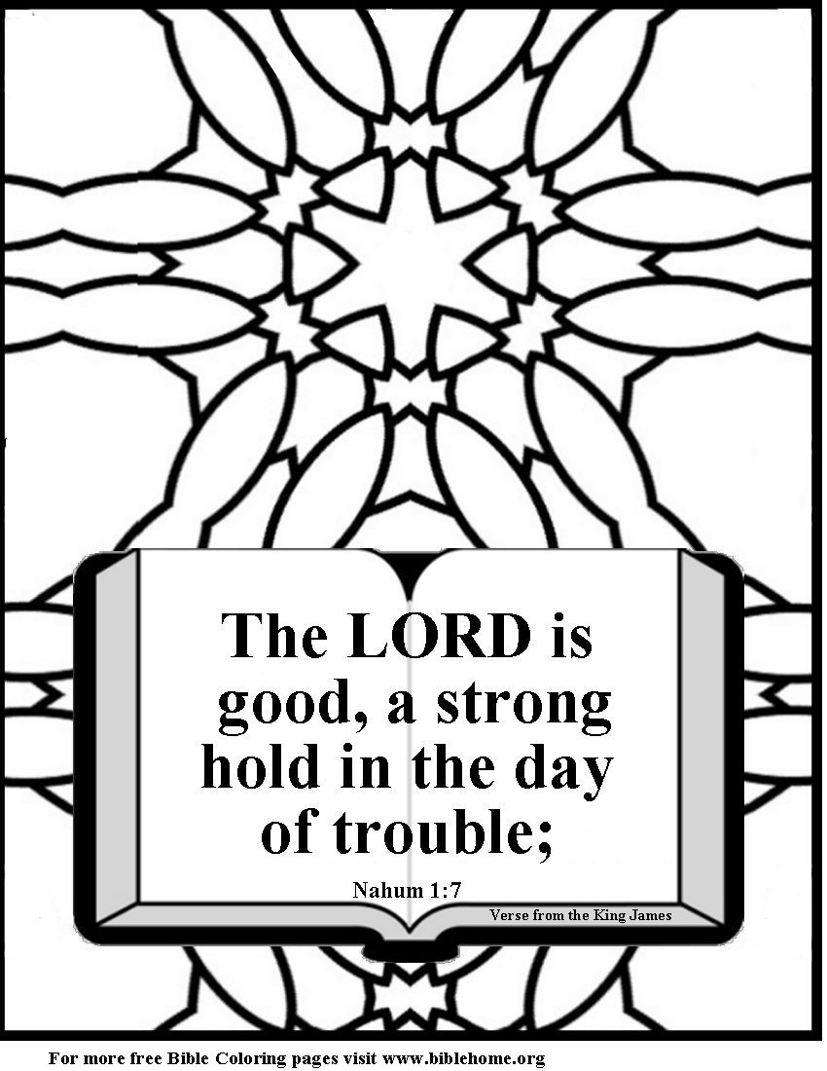
No matter the problem we have two choices.
Give up on God
OR
Pray with all our heart
(and all our friends)
Until He is as real to as the suffering.
To download page from the Internet:
The New English Translation: www.biblehome.org/pdf/setdiv/nd13net.pdf
The King James Translation: www.biblehome.org/pdf/setdiv/nd13kj.pdf
To view more than 20 coloring books visit: http://www.biblehome.org

Slide 15
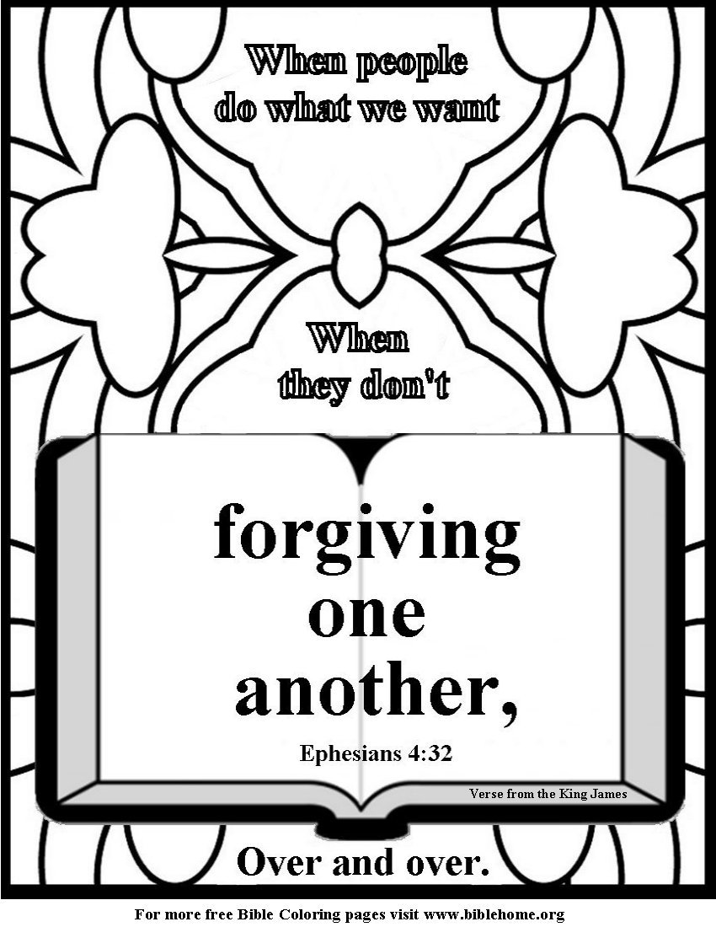
Forgiving is a very big word. It is however the only way we can be forgiven. My favorite definition is: Giving up the right to get even …for small offenses and for large. It is not forgetting the past. It is clearing the way for your child’s future.
To download page from the Internet:
The New English Translation: www.biblehome.org/pdf/setdiv/nd14net.pdf
The King James Translation: www.biblehome.org/pdf/setdiv/nd14kj.pdf

Slide 16
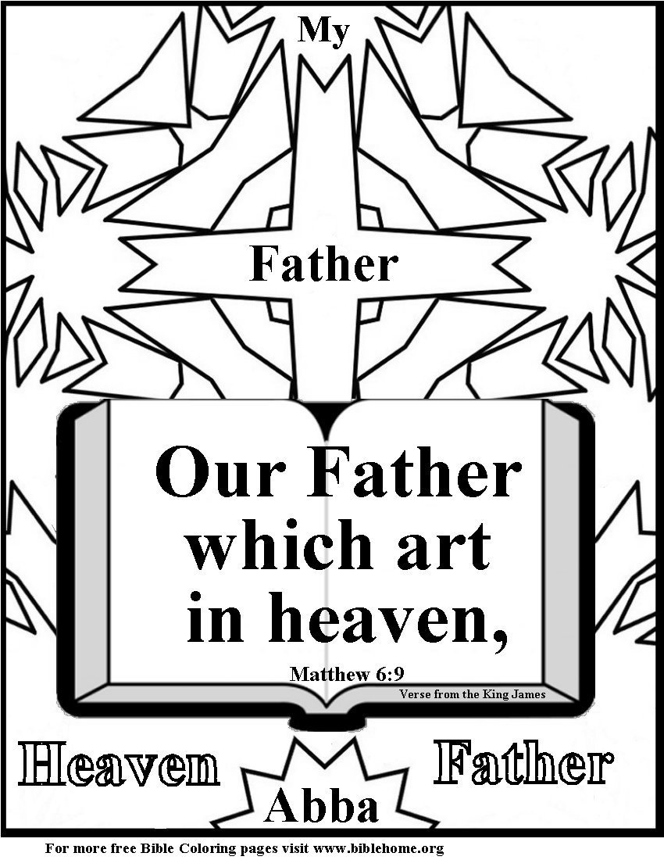
The top three resiliency factors for the children of divorce are: *An intimate relationship with at least one adult. *Regular church attendance. *And deep personal faith. We hope you visit www.teachustopray.com and make a prayer jar.
To download page from the Internet:
The New English Translation: www.biblehome.org/pdf/setdiv/nd15net.pdf
The King James Translation: www.biblehome.org/pdf/setdiv/nd15kj.pdf

Slide 17
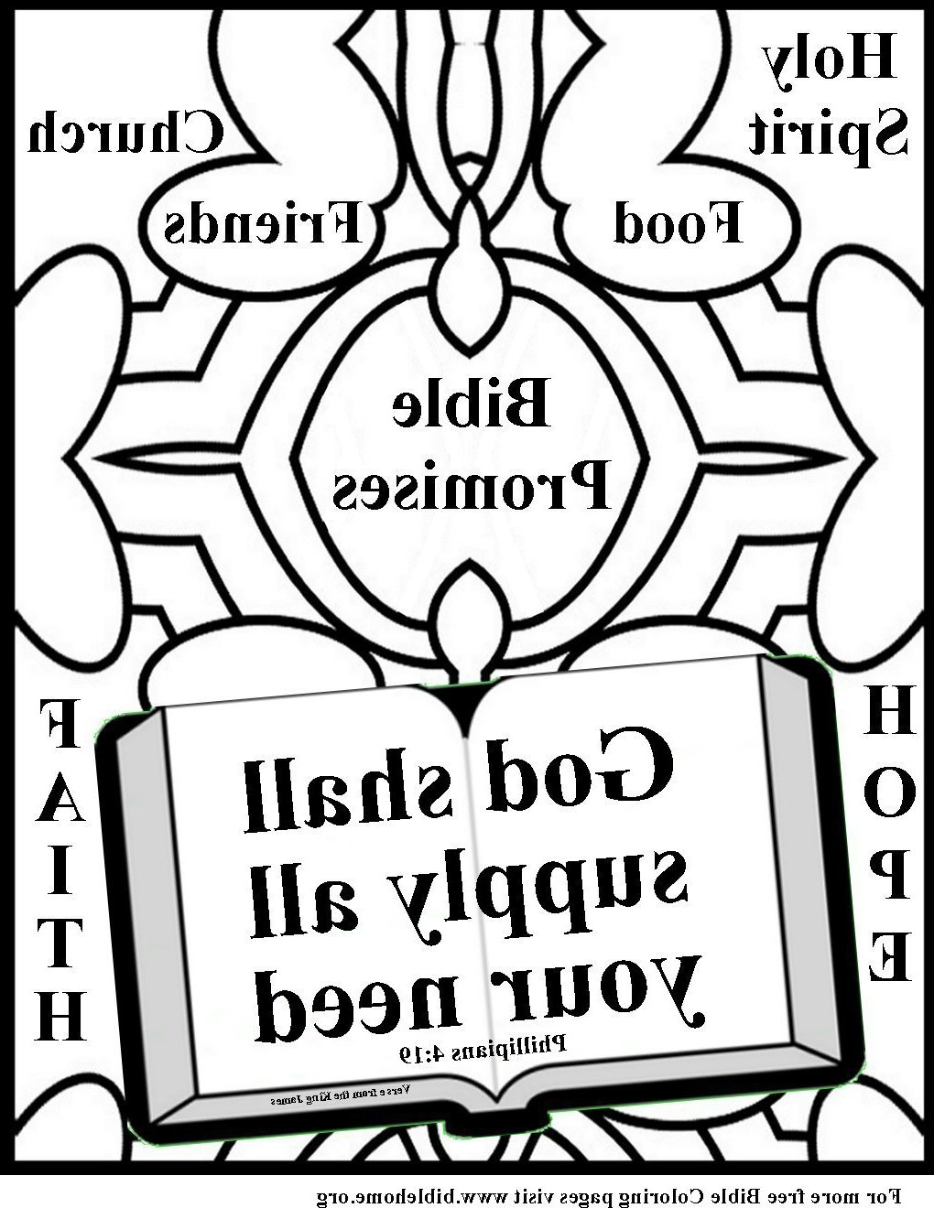
This is a mirror coloring page. Color it and then hold it up to a mirror. Ask God to help you understand. Praying about Bible verses adds power. We hope you color and pray.
To download page from the Internet:
The New English Translation: www.biblehome.org/pdf/setdiv/nd5mnet.pdf
The King James Translation: www.biblehome.org/pdf/setdiv/nd5mkj.pdf
To view more than 20 coloring books visit: http://www.biblehome.org

Slide 18
Melva Noakes was director of the day care in the Oklahoma City Bombing. When I asked her how she kept going she said: “I can’t do much about the children who were killed or injured in the bombing but the children of divorce are hurt much worse and I can help them.”
We hope you and your church share Melva’s heart.
Visit www.childrenafterdivorce.com
Print out some of our Coloring pages, stamp an invitation to attend Sunday School on the back and put them out in car repair shops, Doctors offices etc.
Purchase a 2 CD set with over 4,000 Coloring Pages.
For $20 you get 4,000 plus activities…all the pages from all our sites.
A great gift for your church.
Click here to purchase
For more free coloring books visit www.biblehome.org/

